Slide 1
Harbourview House
AXON TAKE-HOME · KASSEY G
Numbers a director can act on, with resident data kept secure and redacted at every step
Synthetic data, fictional house, data as of 15 January 2026
Notes:
About twenty minutes plus a live demo. The thread through everything: resident data stays secure and redacted. First the main goal and how it shapes the design, then Task A, the dashboard and how each number is counted, then staff notes turned into structured fields, which is where the language model earns its place, then Task B, questions in plain English, then evaluation, what is designed for later, and Task C.

Slide 2
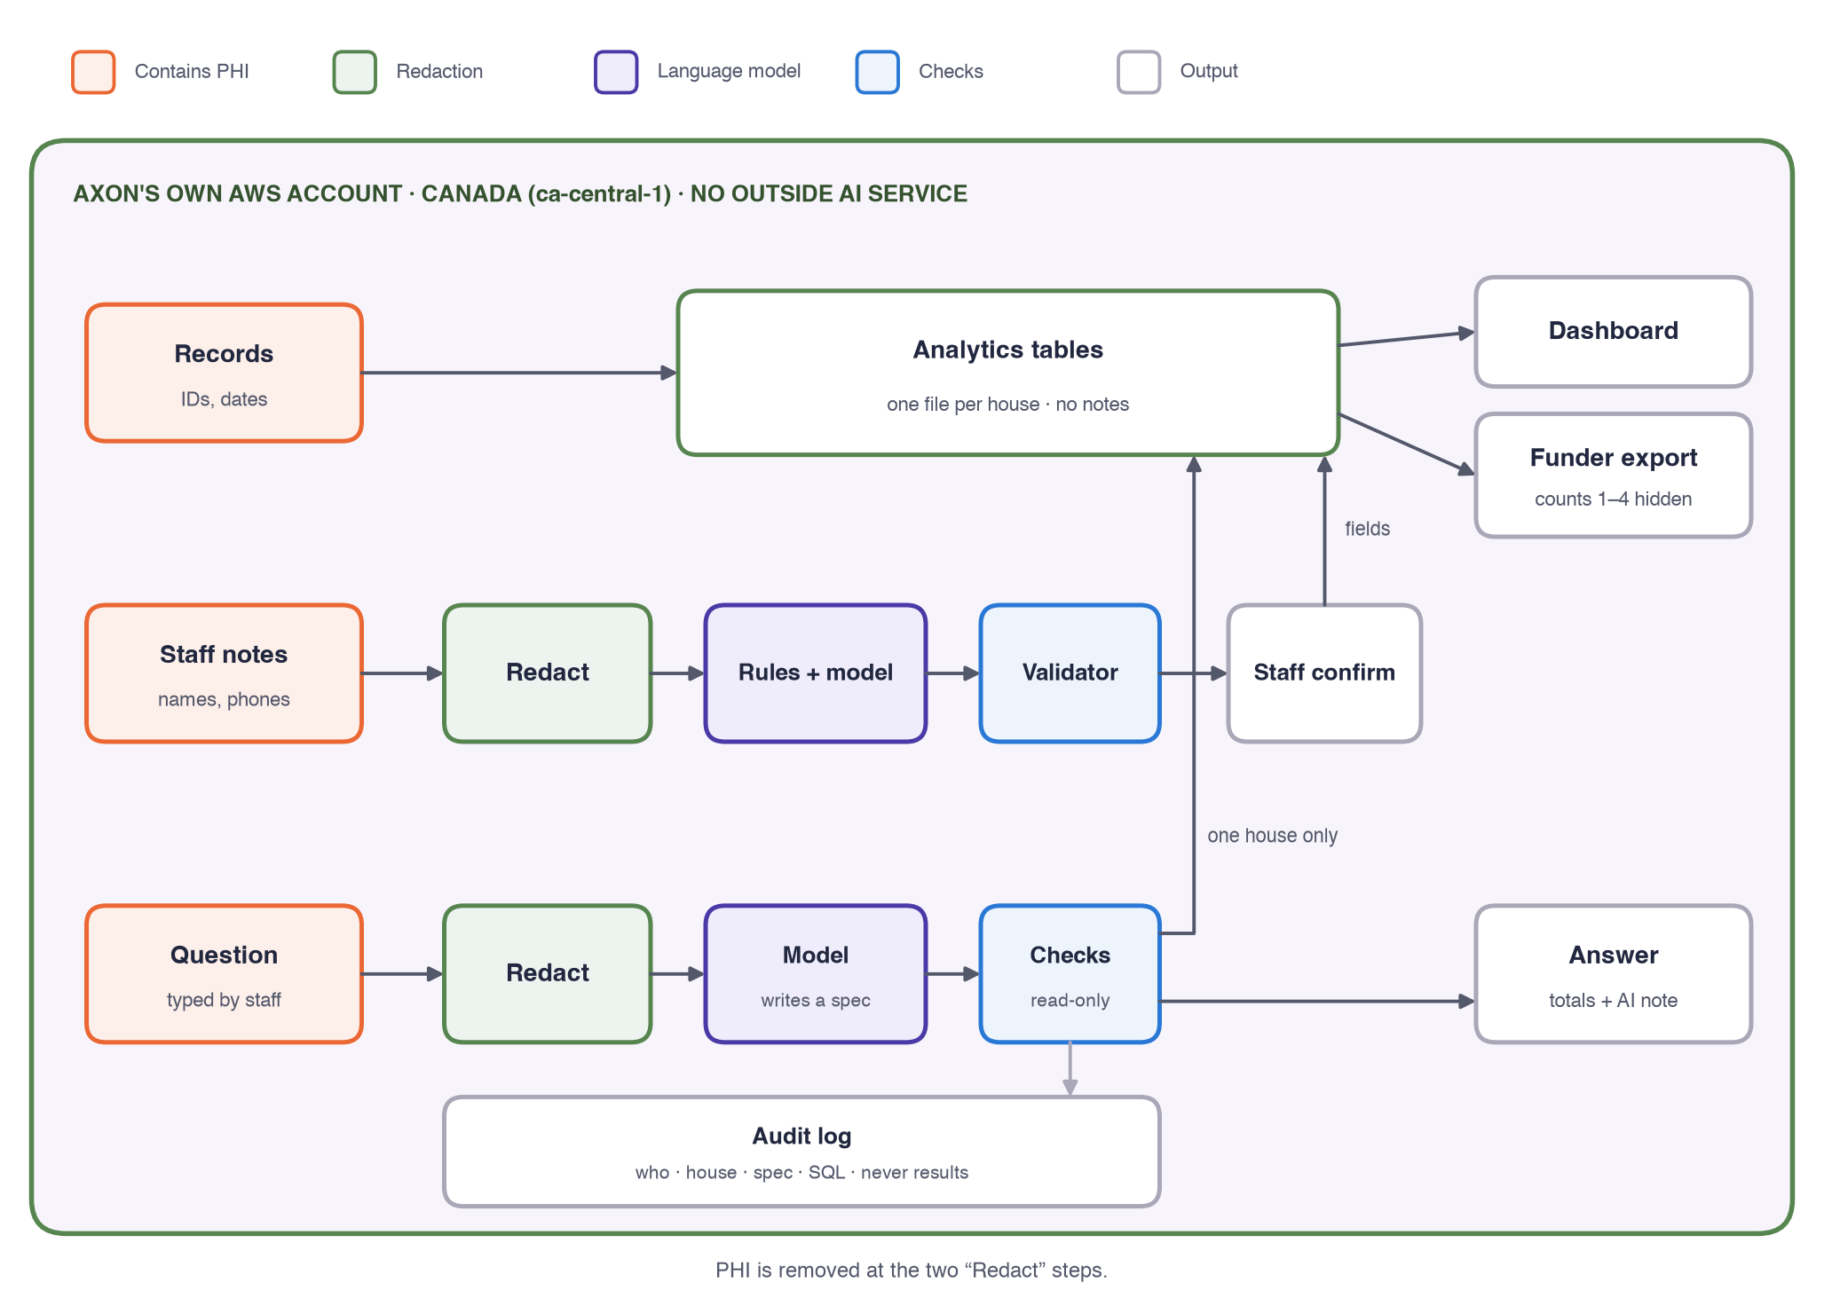
The main goal: resident data stays secure
One place
Everything runs in Axon’s own cloud in Canada. No outside AI service.
Redact first
Names, phones and IDs stripped before any rule or model reads text: 33 of 34 names on a test set.
The model never sees records or results
Not rows, not query results. Every number on screen comes from a query.
Totals only
Nothing about one person. The funder export hides counts from 1 to 4.
Notes:
Orange boxes hold PHI: records, staff notes, and the question someone types. Green is where it is removed. Notes and questions are redacted before rules or the model see them, in layers: identifiers, names next to a word like “brother”, the house's own list of client and contact names, and a name detector that runs locally for names with no context, like “Called Kevin”. On 43 labelled sentences that catches 33 of 34 names, with no false alarms; rules alone caught 18. A question that names a person is declined before the model is called. The model, in violet, is self-hosted inside the same account. It only ever sees redacted text and the catalogue of metrics. The analytics tables hold structured fields, one file per house, and no notes. Every question is logged with who asked, which house, the redacted question, the spec and the SQL, never the results. The app never saves what people type.

Slide 3
What the data said before any chart
In the file | What I did
Latest date 15 Jan 2026; all 190 follow-up statuses agree with it | Used it as the extract date
6 admitted with no intake date; 2 intakes dated before referral | Counted in the funnel, left out of timings
3 left the house with no discharge date | Estimated for occupancy only; left out of length of stay
2 with no discharge reason; 5 coded “other” | Staff notes fill in the exit type, marked AI-assisted; never in funder figures
4 six-month follow-ups due but blank | Own category, “due but not recorded”, kept in the denominator
Data starts July 2024; 12 referrals too recent to judge | FY2024 labelled July to December; 60-day window
Names and phones in 4 notes; 14 blank or “see file” | Redacted before anything reads them; blanks are “no usable note”
Notes:
I profiled the file before charting anything. The extract date is inferred: the latest date is 15 January 2026, and every follow-up value is consistent with six or twelve months after discharge as of that date. Nothing is silently dropped: each problem has a rule that runs on every build. The dashboard is not a data-checking tool, so it doesn't list problem records; this table, the write-up and the design document do, with the full list of sixteen checks. One more from the notes: nine older referrals still have notes saying pending intake, which are probably out of date.

Slide 4
What the director sees first
15 / 24
7
14
4
in the house tonight
new referrals, last 60 days
follow-up calls due in 30 days
follow-ups not recorded
9 beds open
1 waiting, 6 closed (staff notes)
date passed, no result
9 at 6 months, 5 at 12
Neutral facts
Recorded first, notes underneath
One view, one export
Open beds aren’t a warning. Red appears only for a real breach in recorded data: more residents than beds.
Every headline is a recorded field. The notes only explain it, labelled as AI-assisted.
Director and funders share the view. The export hides counts from 1 to 4.
Notes:
The top of the dashboard answers “what is happening now and what needs doing”. Four facts, all from recorded fields. The referral tile is a good example of the rule: the recorded count is 7 referrals in the last 60 days with no intake. Whether they are still waiting is only in the staff notes, which say one is waiting and six are closed, so that split sits underneath, labelled. Below the strip are tabs for flow, occupancy, outcomes, notes and questions. This is the screen I demo live.

Slide 5
Referral to admission: 56%, counted fairly
Referred
129
Only referrals with time to progress
Made by 16 Nov 2025, so each had 60 days. The 12 later ones aren’t counted as failures.
median 6 days, P90 18
Intake
103 (80%)
Times among people who moved on
median 10 days, P90 26
Referral to admission: median 17 days, P90 48.
Admitted
72 (56%)
Notes:
FY2025 referral cohort. Why not all 141 referrals? A referral made on 29 December has had two weeks, not two months, and would count as a failure. Using all of them gives 55%, close here, but the bias grows when referrals spike late in the year. I picked 60 days because 90% of admissions happen within 41 days and the slowest took 71. Six people admitted without an intake date count as reaching intake but are left out of intake timings. Medians and 90th percentiles use linear interpolation, the same as the database, so the dashboard and the question tool agree.

Slide 6
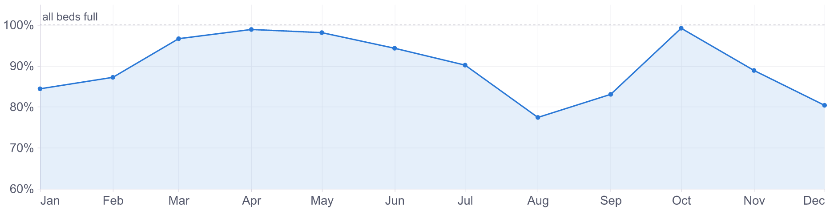
Occupancy and length of stay
BEDS FILLED, FY2025
TYPICAL STAY
90%
95 days
Counting the 14 still in the house. Finished stays alone say 86. Completers stay 128 days, early leavers 46.
Notes:
Occupancy is bed-nights over beds times nights, the standard midnight census. Three people left with no discharge date; I estimated their stay at admission plus 47 days, for occupancy only, and checked it never puts more than 24 people in the house. The chart's axis starts at 60% to show the month-to-month change, and says so. Length of stay: finished stays alone give 86 days, but the 14 people still in the house are the long stays. Kaplan-Meier counts them as “at least this long” and gives 95.

Slide 7
Completing is not the same as leaving
HOW STAYS ENDED, PEOPLE ADMITTED IN FY2025
29
5
24
6
14
■ Completed 29
■ Transferred 5
■ Left by choice 24
■ Discharged by the house 6
■ Custody 1
■ Other or unknown 2
■ Still in the program 14
WHERE PEOPLE WENT NEXT, FROM STAFF NOTES
Recorded reason first
Sober living
8
Notes fill in only reasons coded “other” or left blank (2 here), marked as from notes. The funder report uses recorded reasons only.
Home or family
6
Another program
3
Detox or custody
3
Not stated
47
Notes:
The brief asks to separate completion from discharge. Exit type comes from the recorded discharge reason: completed, transferred, left by choice, discharged by the house. Where the reason is “other” or blank, the staff note fills it in, for example incarceration becomes custody, and it is marked as coming from a note. Where people went next is only in the notes: 8 to sober living, 6 home or to family, 3 to another program; 47 notes don't say. Sage and orange are never side by side, so the bar reads for colour-blind viewers too, and every colour has its count in the legend.

Slide 8
ENGAGED IN RECOVERY AT 6 MONTHS, FY2025
46–85%
Out of all 41 people who left in FY2025 and are due. Counting only the 25 we reached would say 76%, and hide everyone we lost touch with.
Notes:
The slide I'd most want a funder to remember. 19 people were confirmed engaged in recovery out of 41 who left the house in FY2025 and whose six-month date has passed, including people who left early. 16 couldn't be reached or have no result. So the honest answer is a range: 46% if none of them are engaged, 85% if all of them are. The common practice, engaged among those reached, would say 76%. That is survivorship bias, and the dashboard never shows it. Across all years the range is 41 to 84% of 51.

Slide 9
Everyone due stays in the denominator
6-MONTH FOLLOW-UP, EVERYONE WHO LEFT IN FY2025 AND IS DUE
19
10
2
4
6
16 with no known outcome: 46% if none engaged, 85% if all did
■ Engaged in recovery
■ Lost to follow-up
■ Unknown
■ Due, not recorded
■ Relapse reported
Unknowns kept apart
Completers vs early leavers
Too few: counts only
Lost, unknown and never entered are separate. The last is a gap the house can fix.
15 of 22 completers confirmed engaged; 4 of 19 early leavers.
Under 20 due, no range is shown: 12 months has 3 due; FY2024 has 8.
Notes:
The denominator is everyone admitted who left the house in the fiscal year and whose follow-up date, counted from discharge, has passed. Early leavers are included; the result would look better without them and would be wrong. The three no-outcome categories are graded greys so uncertainty reads as uncertainty, and the bracket marks exactly that stretch: the true engaged share lies somewhere across it. Under 20 people due, the dashboard shows the counts and says “too few to judge” rather than a range. In the funder export, counts from 1 to 4 are hidden, along with any count that could be worked out by subtraction.

Slide 10
Staff notes hold what the fields don’t
In the house
“Res. back from weekend pass, appears well, attending NA 3x/wk”
Meetings and groups, passes, incidents, mood and risk flags
back from pass
doing well
attending groups
After leaving
“Self-discharged. Stated wanted to go home.”
Why they left, where they went next
left by choice
went home or to family
Referrals not admitted
Still open or closed, and why
“Called x3, no answer, mailbox full. Closing.”
referral closed: unreachable
Which fields can apply depends on where the person is, so an old incident is never read as a current risk.
“Weekend pass approved for a family visit.”
nothing: approved isn’t taken
Notes:
This is where the language model earns its place. The structured fields say a referral wasn't admitted; the note says why, and whether it is still open. The fields say “other”; the note says custody. Wellbeing and passes are recorded nowhere else. The first example is the brief's own. The last one is a correction from my own review of the labelled set: a pass that was approved hasn't been taken, so the rule was tightened and the label changed. Every value keeps the words it came from.

Slide 11
Notes become metrics, labelled as AI-assisted
WHY FY2025 REFERRALS WEREN’T ADMITTED
IN THE HOUSE NOW, OF 15
No-show
16
4
Waitlisted (open)
12
attending meetings or groups
Unreachable
11
4
Pending intake (open)
8
with a mood or risk flag
Declined
6
2
with an incident
Referred out
4
Not appropriate
3
0
with a pass mentioned
No usable note
4
64 referrals not admitted. Blue: still open. Orange: closed.
Notes:
On the dashboard these sit inside the metrics, not in a review queue: the dashboard is not a data-validation tool. Each carries an AI-assisted note. Funder figures use recorded fields only. The biggest finding: of 64 FY2025 referrals that weren't admitted, the notes say 20 are still open, waitlisted or pending intake, and most of the rest closed because the person didn't show or couldn't be reached, which is something the house can act on. Zero passes is real: no note in this file mentions one, so the pass categories were tested on reworded notes.

Slide 12
How a note becomes a field, safely
Redact
Rules
Model
Validator
Metrics
Names, phones, IDs out first
Familiar wording
Fixed fields, must quote the note
Quote in the note; field fits the person
AI-assisted label; risk to staff
94%
25%
100%
5
of findings found by rules and model together, at 91% precision
rules alone, on notes worded in new ways: why the model is there
of risk flags found; each one still goes to a person
invented quotes caught and rejected by the validator
70 labelled notes: 47 from the file, 23 reworded. I reviewed every label: 69 confirmed, 1 corrected.
Notes:
Redaction happens before anything reads the note. Rules handle the wording staff use most and are precise. The self-hosted model fills a fixed set of fields and must quote the words it relied on; the validator rejects any quote that isn't in the note and any field that can't apply to where the person is, for example a discharge reason for someone still in the house. On 70 labelled notes, rules alone find only a quarter of findings in notes worded differently; with the model, 94% at 91% precision. The model's main mistakes: it still reads “weekend pass approved” as a pass taken, and it guessed a self-discharge from “discharged, see paper file”. That is why its values carry an AI-assisted label and stay out of funder figures.

Slide 13
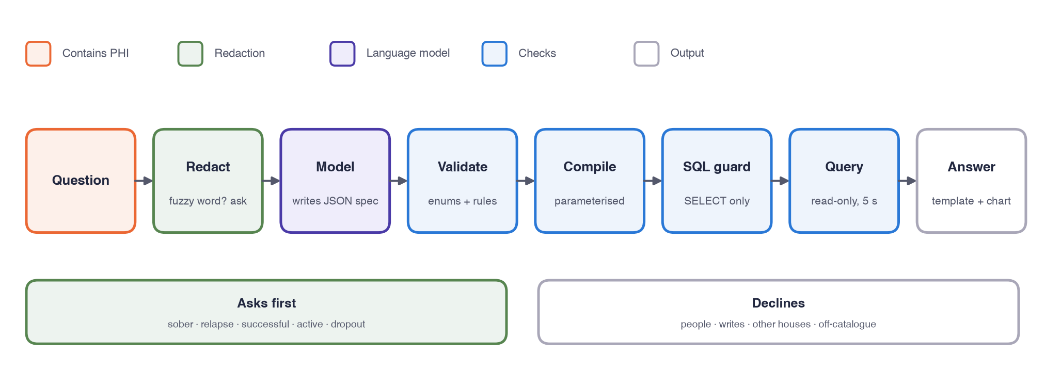
From a question to a checked answer
The model only fills in a spec. It never sees data, never writes SQL, and nothing it writes is shown.
Notes:
The language model has one job here: turn words into a small JSON spec drawn from a catalogue of ten metrics. Code does everything else: validation, compiling to parameterised SQL, a guard that allows one SELECT on allow-listed tables, a read-only query against one house's file, and the answer text, written by templates from the result. Before the model is called, the question is redacted; a name, phone or resident ID means it's about a person and it's declined. Phrases that try to change the instructions are also declined before the model. Live demo here.

Slide 14
It asks instead of assuming
What percentage of residents were sober at 6 months?
Of 51 people whose 6-month follow-up was due, 21 (41%) were confirmed engaged in recovery. 22 have no known outcome, so the true share is between 41% and 84%.
What should “sober” mean here?
Sobriety isn’t recorded. Follow-ups record “engaged in recovery”, “relapse reported”, or that the person couldn’t be reached.
“sober” = engaged in recovery at 6 months, out of everyone due. Version 1.
AI-assisted: the model turned the question into a query. Every number comes from the query.
Engaged in recovery at 6 months, out of everyone due
Engaged in recovery at 12 months, out of everyone due
Fuzzy words: sober, relapse, successful, active, dropout, this year
Choices come from the catalogue, never invented
Saved per house, versioned, applied by code to later questions
Don’t pick one number: show every 6-month outcome
Notes:
A fuzzy term gets a question, not an assumption. A glossary lists words with no single meaning. If one appears and the house hasn't defined it, the agent asks before the model is even called. The choices are concrete catalogue options. The answer is saved as the house's definition, with who and when, and applied by code to the spec, so the model can't drift from it. This answer covers all years; the dashboard shows the same measure for FY2025. Every answer names the definition it used and carries the AI-assisted note, as Axon does on its own AI-assisted reports. The model also flags words it can't map, like “how are our graduates doing?”, and then the choices are catalogue metrics it suggested.

Slide 15
Seven layers between the model and the data
Layer | Stops | Tested by
Redaction and rules before the model | Names, even with no context; questions about a person; attempts to change the instructions | 43 labelled sentences
Schema with every id as an enum | Made-up metrics, fields and values | 45-question evaluation
Strict parse, no extra fields | A house slipped into the spec | Unit tests
Rules per metric | Combinations that mean nothing; status for a past date | 8 invalid specs
House definitions applied in code | The model picking its own meaning | Agent tests
SQL guard | Writes, file reads, other tables | 18 attack queries
Read-only file per house | Anything that slips past the guard | 6 attacks, guard off
In MongoDB: a read-only user, a stage allow-list that rejects $out and $merge, maxTimeMS, and a database per customer chosen from the login.
Notes:
Each layer assumes the one before it failed. The last is the database itself: the connection is read-only, file access and extensions are off, and the settings are locked, so even SQL that skipped the guard can't write, can't read the other house's file, and can't turn the protections back off. Tenant isolation is tested by running the same spec for both houses and with a question that asks for the other house. I used DuckDB to keep the prototype easy to run; the spec is engine-neutral, and for Axon's MongoDB the compiler would target aggregation pipelines with the rules at the bottom of the slide.

Slide 16
Where the model runs
Option | Text stays in Canada? | Decision
Open model, self-hosted in Axon’s AWS account, ca-central-1 | Yes; no outside company processes it | Chosen
Amazon Bedrock (Claude), ca-central-1 | No: routes to US regions | Not chosen
Google Vertex AI, Montréal endpoint | Yes, if pinned | Adds a second cloud and processor
Anthropic API directly | No: US or global | Not chosen for PHI
The prototype
Why self-hosted
Google’s Gemma 3 12B, run locally with Ollama. No paid API; nothing leaves the laptop. About 10 seconds a question.
Matches Axon running on AWS with a database per organization. One account, one region, one set of controls.
Notes:
Data minimisation comes first: the model never receives a record, and its input is redacted. Hosting comes second. Under PIPEDA Axon stays accountable for any processor; where a customer is a health information custodian under PHIPA, Axon acts as its agent or service provider, with limited use, an audit trail and breach reporting. Some funders require data to stay in Canada. A self-hosted open model in Axon's own AWS account in Canada avoids a third-party processor entirely. Residency options were checked in October 2026 and should be re-checked before signing anything. The trade-off: a 12B model is slower and less accurate than a large hosted one, and the evaluation measures that honestly.

Slide 17
How I know it works
48 LABELLED QUESTIONS
RESULTS, GEMMA 3 12B, LOCAL
Kind | Questions
Answerable | 27
With a saved house definition | 3
Must ask a clarifying question | 7
Must decline | 8
0
unsafe answers
98%
right kind of reply: answer, ask or decline
100%
clarification precision and recall
71%
same numbers as the expected answer
Plus 194 automated tests: metric edge cases, privacy, query safety, tenant isolation, the dashboard and the question tool agreeing.
Misses are wrong groupings or filters, never invented numbers.
Notes:
Two kinds of checking. Automated tests pin every metric definition with hand-built edge cases, run every attack query, and check the dashboard and the question tool give the same numbers. The evaluation set checks the model step; I reviewed every question and every labelled note in a spreadsheet, and a script read my corrections back, validated them and applied them. The key metric is execution accuracy: two different specs can be equally right, so I compare the numbers they return. Safety is where the rules carry the load: zero unsafe answers, every decline for an acceptable reason. Where the 12B model falls short is picking the exact grouping or filter, for example splitting by completion group when nobody asked. The answer is still a true number, just not the one asked for. Recordings are keyed by model, prompt and question, so any change means re-recording and re-scoring.

Slide 18
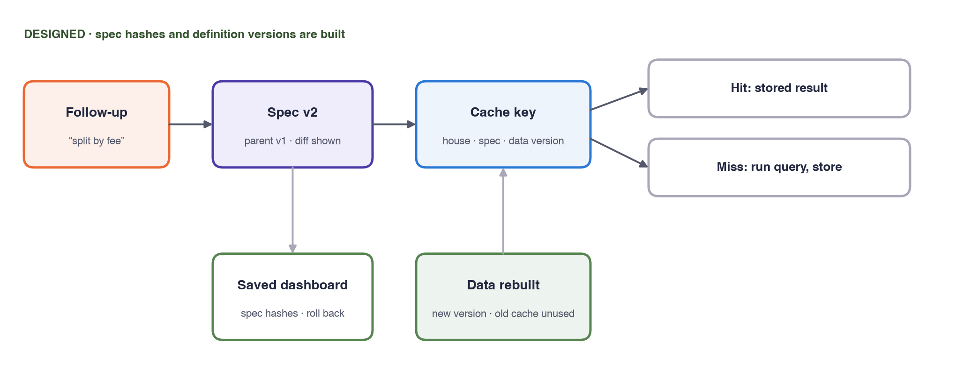
Iteration, versions and caching
Built
Designed
Spec hashes, versioned house definitions, the audit log
Follow-ups as spec diffs, saved dashboards with roll-back, a cache that can’t serve stale results
Notes:
Iteration: a follow-up like “now split by fee” sends the previous spec and the request; the model returns a changed spec, shown as a difference before it runs. Version control: a saved dashboard is a list of spec hashes plus layout, stored per house with its parent version, author and time, so changes can be reviewed and rolled back. House definitions already work this way. Caching: results are keyed by house, spec hash, data version and definition version. Rebuilding the data changes the data version, so a stale result can never be served. I built the pieces the rest depends on and designed the rest, to keep the prototype honest about scope.

Slide 19
Task C: notes, accuracy, one prediction
C1 · NOTES TO FIELDS, BUILT
C2 · ACCURACY
C3 · ONE PREDICTION
Rules, then a model, then people
Double-labelled notes, recall first
Who we may lose touch with
At discharge, flag who may be unreachable at 6 months, so staff gather contacts and call sooner. It narrows the 46 to 85% range.
Redact first. Rules for familiar wording; a self-hosted model fills a fixed schema and quotes its evidence. Risk flags always go to staff.
500 to 1,000 notes, rare events over-sampled. F1 per field, recall first for risk. Re-run on every change; watch override rates.
C3 ships only if it can add outreach but never remove care, beats a simple rule on new houses, and is equally accurate across groups.
Notes:
C1 is built, and the notes slides showed it. Notes are short and full of abbreviations, which suits a model, but risk items are too important to automate fully, so they always go to a person, and every value keeps its quote. C2: two trained staff label each note; their agreement is the ceiling; recall matters most for risk flags because a miss can cause harm. Reviewers' corrections become new labels. C3: I picked lost-to-follow-up risk over self-discharge risk because the action is low-harm, an extra phone call, and it improves the outcome numbers funders see. Harbourview alone is far too small; it needs pooled data from many houses under agreements. The main risks are bias against people with unstable housing, small samples, and misuse such as choosing whom to call to make the numbers look better.

Slide 20
Trade-offs, and what I’d do next
TRADE-OFFS I CHOSE
NEXT
A narrow catalogue: some questions are declined rather than answered wrongly
A local 12B model: private and free, slower and less exact than a large one
Redaction removes a word rather than risk missing a name
DuckDB for the prototype, with the MongoDB rules written up
Fix the wrong groupings and filters the evaluation still finds
Feed the name list from the case-management system
Grow the evaluation from real, redacted questions
Record each follow-up attempt with its date
Notes:
The biggest trade-off is scope. A narrow catalogue means the tool says no more often than a free-form SQL bot would, but every number it gives has passed every check. The local model keeps everything private and costs nothing, and the evaluation shows where it still picks the wrong grouping or filter; that is the first thing I'd work on, without tuning to the test set. Next for privacy: the name list should come straight from the case-management system, and the redaction test set should grow from real notes. For the data: dated follow-up attempts, so we can measure outreach effort, not just results. Happy to go into any metric definition in detail.

